Slide 1
Ranges for the Standard Library
C++Con 2015
Eric Niebler

Slide 2
Welcome to This Talk!
What are ranges good for?
What parts make up the whole of ranges?
How do the parts play together?
Why should you care?
What has been proposed for standardization? What will be proposed? When will it land?
The idea for this talk was taken from the article “Component programming with ranges” on the D language Wiki.

Slide 3
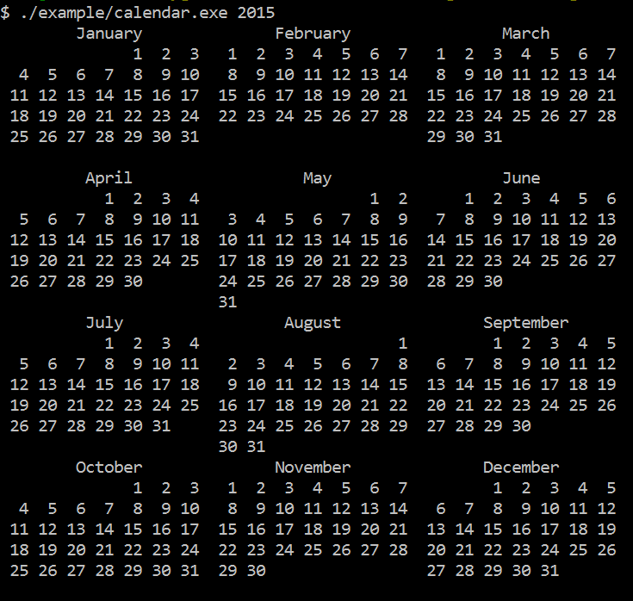
Goal

Slide 4
#include <cstddef>
#include <string>
#include <vector>
#include <utility>
#include <iostream>
#include <stdexcept>
#include <functional>
#include <boost/format.hpp>
#include <boost/lexical_cast.hpp>
#include <boost/date_time/gregorian/gregorian.hpp>
#include <range/v3/all.hpp>
namespace greg = boost::gregorian;
using date = greg::date;
using day = greg::date_duration;
using namespace ranges;
using std::cout;
namespace boost { namespace gregorian {
date &operator++(date &d) { return d = d + day(1); }
date operator++(date &d, int) { return ++d - day(1); }
}}
namespace ranges {
template<> struct difference_type<date> {
using type = date::duration_type::duration_rep::int_type;
};
}
CONCEPT_ASSERT(Incrementable<date>());
auto dates_in_year(int year) {
return view::iota(date{year,greg::Jan,1},
date{year+1,greg::Jan,1});
}
auto by_month() {
return view::group_by([](date a, date b) {
return a.month() == b.month();
});
}
auto by_week() {
return view::group_by([](date a, date b) {
// ++a because week_numer is Mon-Sun and we want Sun-Sat
return (++a).week_number() == (++b).week_number();
});
}
std::string format_day(date d) {
return boost::str(boost::format("%|3|") % d.day());
}
// In: Range<Range<date>>: month grouped by weeks.
// Out: Range<std::string>: month with formatted weeks.
auto format_weeks() {
return view::transform([](/*Range<date>*/ auto week) {
return boost::str(boost::format("%1%%2%%|22t|")
% std::string((int)front(week).day_of_week() * 3, ' ')
% (week | view::transform(format_day) | action::join));
});
}
// Return a formatted string with the title of the month
// corresponding to a date.
std::string month_title(date d) {
return boost::str(boost::format("%|=22|")
% d.month().as_long_string());
}
// In: Range<Range<date>>: year of months of days
// Out: Range<Range<std::string>>: year of months of formatted wks
auto layout_months() {
return view::transform([](/*Range<date>*/ auto month) {
int week_count = distance(month | by_week());
return view::concat(
view::single(month_title(front(month))),
month | by_week() | format_weeks(),
view::repeat_n(std::string(22,' '),6-week_count));
});
}
// In: Range<T>
// Out: Range<Range<T>>, where each inner range has $n$ elements.
// The last range may have fewer.
template<class Rng>
class chunk_view : public range_adaptor<chunk_view<Rng>, Rng> {
CONCEPT_ASSERT(ForwardIterable<Rng>());
std::size_t n_;
friend range_access;
class adaptor;
adaptor begin_adaptor() {
return adaptor{n_, ranges::end(this->base())};
}
public:
chunk_view() = default;
chunk_view(Rng rng, std::size_t n)
: range_adaptor_t<chunk_view>(std::move(rng)), n_(n)
{}
};
template<class Rng>
class chunk_view<Rng>::adaptor : public adaptor_base {
std::size_t n_;
range_sentinel_t<Rng> end_;
using adaptor_base::prev;
public:
adaptor() = default;
adaptor(std::size_t n, range_sentinel_t<Rng> end)
: n_(n), end_(end)
{}
auto current(range_iterator_t<Rng> it) const {
return view::take(make_range(std::move(it), end_), n_);
}
void next(range_iterator_t<Rng> &it) {
ranges::advance(it, n_, end_);
}
};
// In: Range<T>
// Out: Range<Range<T>>, where each inner range has $n$ elements.
// The last range may have fewer.
auto chunk(std::size_t n) {
return make_pipeable([=](auto&& rng) {
using Rng = decltype(rng);
return chunk_view<view::all_t<Rng>>{
view::all(std::forward<Rng>(rng)), n};
});
}
// Flattens a range of ranges by iterating the inner
// ranges in round-robin fashion.
template<class Rngs>
class interleave_view : public range_facade<interleave_view<Rngs>> {
friend range_access;
std::vector<range_value_t<Rngs>> rngs_;
struct cursor;
cursor begin_cursor() {
return {0, &rngs_, view::transform(rngs_, ranges::begin)};
}
public:
interleave_view() = default;
explicit interleave_view(Rngs rngs)
: rngs_(std::move(rngs))
{}
};
template<class Rngs>
struct interleave_view<Rngs>::cursor {
std::size_t n_;
std::vector<range_value_t<Rngs>> *rngs_;
std::vector<range_iterator_t<range_value_t<Rngs>>> its_;
decltype(auto) current() const {
return *its_[n_];
}
void next() {
if(0 == ((++n_) %= its_.size()))
for_each(its_, [](auto& it){ ++it; });
}
bool done() const {
return n_ == 0 && its_.end() != mismatch(its_,
view::transform(*rngs_, ranges::end), std::not_equal_to<>()).first;
}
CONCEPT_REQUIRES(ForwardIterable<range_value_t<Rngs>>())
bool equal(cursor const& that) const {
return n_ == that.n_ && its_ == that.its_;
}
};
// In: Range<Range<T>>
// Out: Range<T>, flattened by walking the ranges
// round-robin fashion.
auto interleave() {
return make_pipeable([](auto&& rngs) {
using Rngs = decltype(rngs);
return interleave_view<view::all_t<Rngs>>(
view::all(std::forward<Rngs>(rngs)));
});
}
// In: Range<Range<T>>
// Out: Range<Range<T>>, transposing the rows and columns.
auto transpose() {
return make_pipeable([](auto&& rngs) {
using Rngs = decltype(rngs);
CONCEPT_ASSERT(ForwardIterable<Rngs>());
return std::forward<Rngs>(rngs)
| interleave()
| chunk(distance(rngs));
});
}
// In: Range<Range<Range<string>>>
// Out: Range<Range<Range<string>>>, transposing months.
auto transpose_months() {
return view::transform([](/*Range<Range<string>>*/ auto rng) {
return rng | transpose();
});
}
// In: Range<Range<string>>
// Out: Range<string>, joining the strings of the inner ranges
auto join_months() {
return view::transform([](/*Range<string>*/ auto rng) {
return action::join(rng);
});
}
int main(int argc, char *argv[]) try {
if(argc < 2) {
std::cerr << "Please enter the year to format.\n";
std::cerr << boost::format(" Usage: %1% <year>\n") % argv[0];
return 1;
}
int year = boost::lexical_cast<int>(argv[1]);
int months_per_line = 3;
auto calendar =
// Make a range of all the dates in a year:
dates_in_year(year)
// Group the dates by month:
| by_month()
// Format the month into a range of strings:
| layout_months()
// Group the months that belong side-by-side:
| chunk(months_per_line)
// Transpose the rows and columns of the size-by-side months:
| transpose_months()
// Ungroup the side-by-side months:
| view::join
// Join the strings of the transposed months:
| join_months();
// Write the result to stdout:
copy(calendar, ostream_iterator<>(std::cout, "\n"));
}
catch(std::exception &e) {
std::cerr << "ERROR: Unhandled exception\n";
std::cerr << " what(): " << e.what();
return 1;
}

Slide 5
Step 1
Create a range of dates.

Slide 6
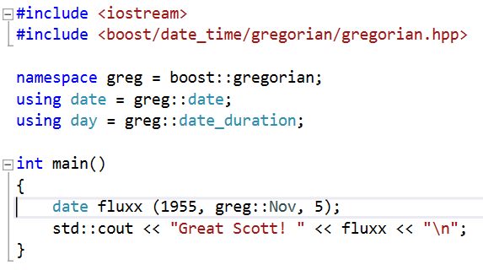

Hello, Date_time!

Slide 7
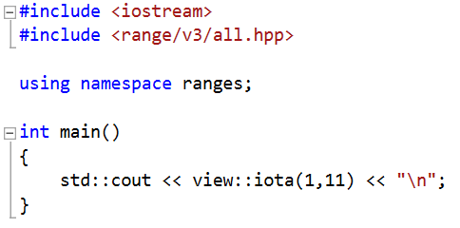

Hello, Range!
Range-v3: https://github.com/ericniebler/range-v3

Slide 8
Range Views
Begin/end members return iterator/sentinel
Lazy sequence algorithms
Lightweight, non-owning
Composable
Non-mutating

Slide 9
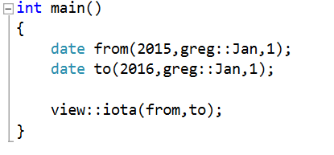
Range of dates = ☹

Slide 10
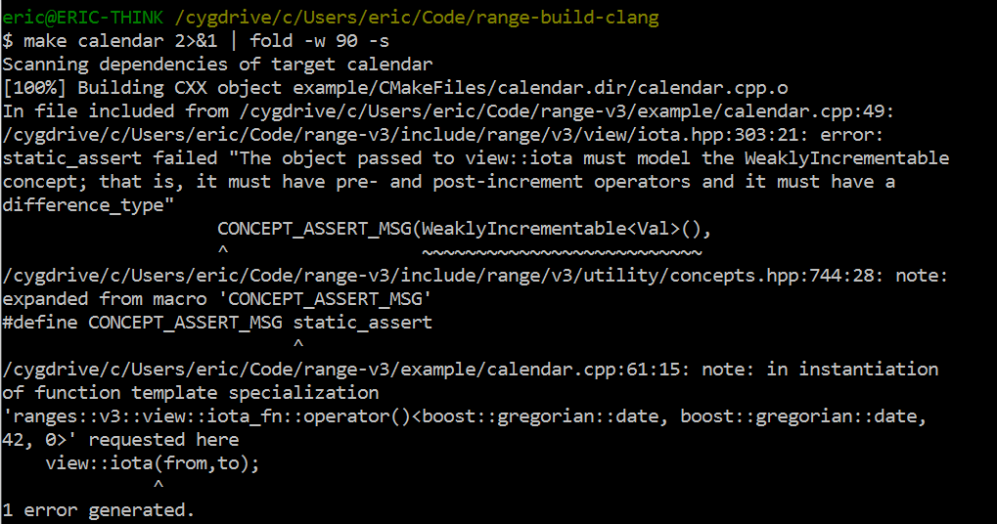
Range of dates = ☹

Slide 11
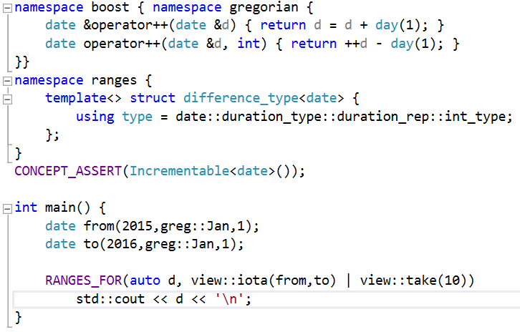
Range of dates = HACKHACK

Slide 12
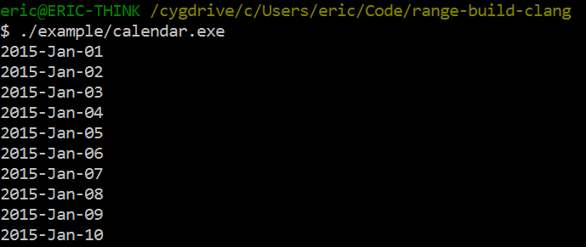
Range of dates = HACKHACK
Don’t do this.

Slide 13
Step 2
Group the range of dates into months.

Slide 14
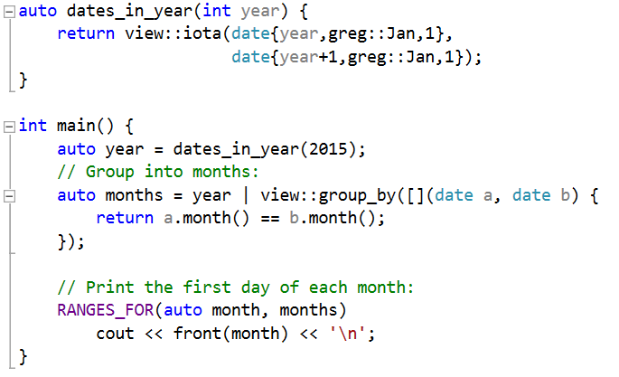
Group Dates into Months

Slide 15
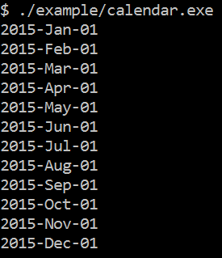
Group Dates into Months

Slide 16
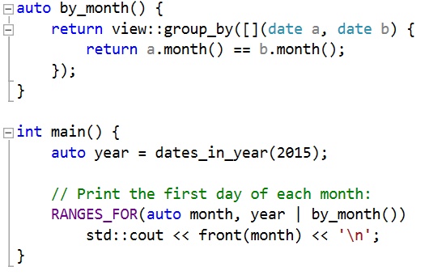
Refactor for Readability
Move the group_by expression into its own named adaptor.

Slide 17
Built-in Range Views
adjacent_remove_if | drop_while | map | split
all | empty | move | stride
any_range | filter | partial_sum | tail
bounded | for_each | remove_if | take
c_str | generate | repeat | take_exactly
chunk | generate_n | repeat_n | take_while
concat | group_by | replace | tokenize
const_ | indirect | replace_if | transform
counted | intersperse | reverse | unbounded
delimit | iota | single | unique
drop | join | slice | zip[_with]

Slide 18
Step 3
Group months into weeks.

Slide 19
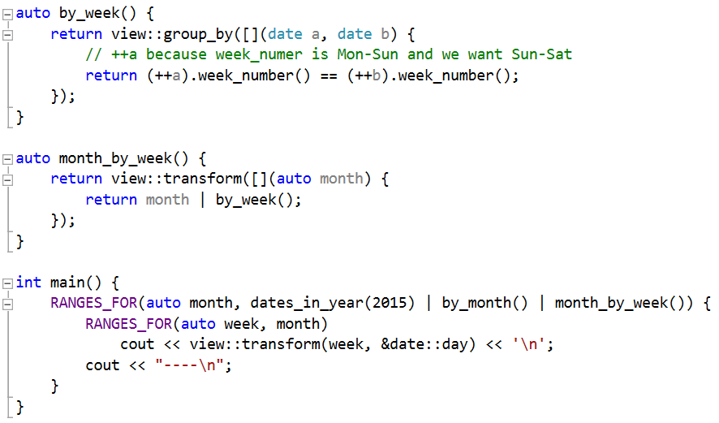
Group Months into Weeks

Slide 20
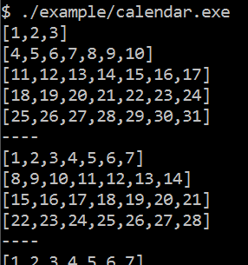
Group Months into Weeks

Slide 21
Step 4
Format the weeks

Slide 22

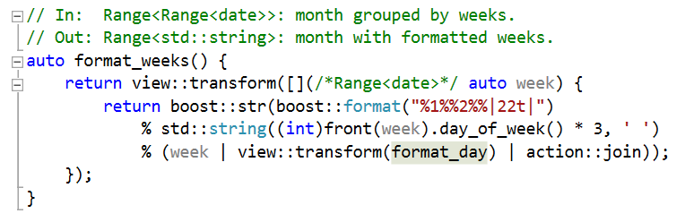
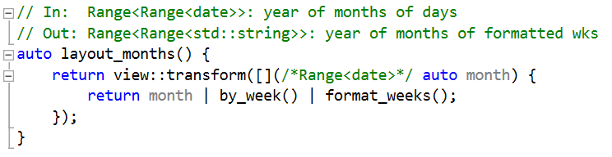
Format the Weeks

Slide 23
Range Actions
Eager sequence algorithms
Can operate on and return containers
Composable
Potentially mutating

Slide 24
Views vs. Actions
Range Views | Range Actions
Lazy sequence algorithms | Eager sequence algorithms
Lightweight, non-owning | Can operate on and return containers
Composable | Composable
Non-mutating | Potentially mutating

Slide 25
Built-in Range Action
drop | push_front | stable_sort
drop_while | remove_if | stride
erase | shuffle | take
insert | slice | take_while
join | sort | transform
push_back | split | unique

Slide 26
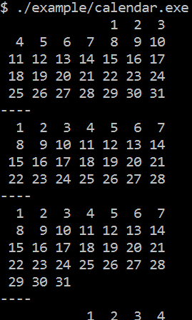
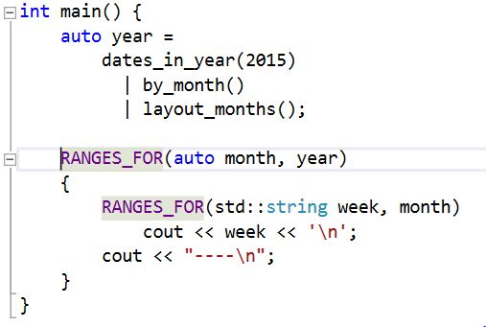
So Far, So Good

Slide 27
Step 5
Add month title and padded weeks.

Slide 28
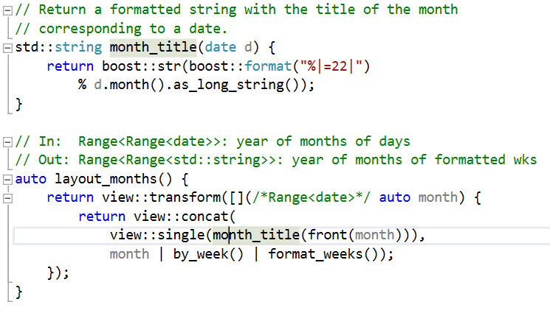
Month Title
view::concat lazily concatenates ranges.
view::single creates a 1-element range.

Slide 29
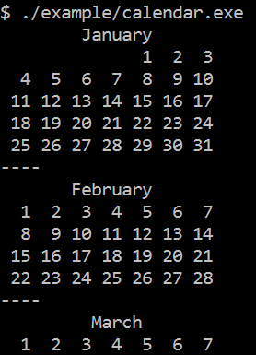
Month Title

Slide 30
Padding Short Months
A formatted month takes as few as four and as many as six lines.
For side-by-side display of months, they must all occupy the same vertical space.
Pad the short months with empty lines.

Slide 31
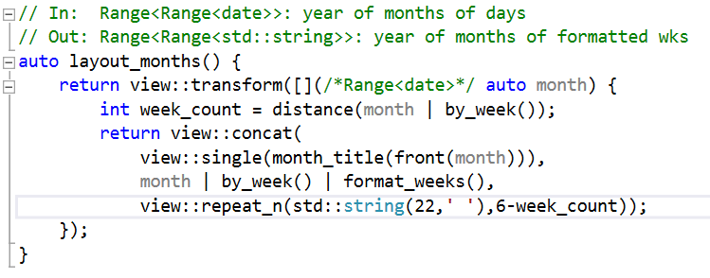
Padding Short Months
view::repeat_n creates an N-element range.

Slide 32
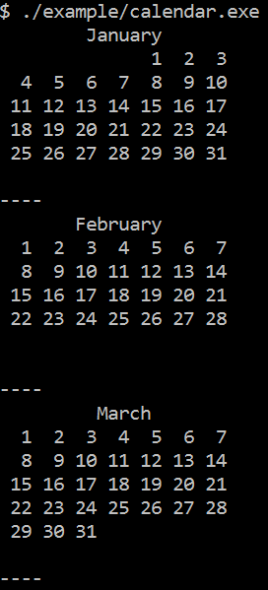
Padding Short Months

Slide 33
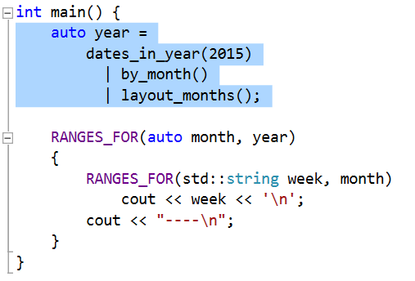
So Far, So Good
A “year” is a range of “months”.
A “month” is a range of strings.
Each “month” has exactly 7 lines.
by_month() and layout_months() are reusable, and work even if the input range of dates is infinite!
Notes:
Range-based programs are declarative and functional.
Not stateful!

Slide 34
Side-by-Side Month Layout
???

Slide 35
Side-by-Side Month Layout
J
F
M
A
M
J
J
A
S
O
N
D
J | F | M
A | M | J
J | A | S

Slide 36
Side-by-Side Month Layout
Chunk months into groups of 3’s.
For each group of 3 months, transpose the “rows” and “columns”.
Join the chunks created in step 1.
Join the strings of the inner ranges.
Print!
Take the rest of the day off.

Slide 37

Adaptor Pattern
“[…] the adapter pattern is a software design pattern that allows the interface of an existing class to be used from another interface.”
-- Wikipedia,
https://en.wikipedia.org/wiki/Adapter_pattern

Slide 38
Range Adaptors
Adaptor Range
Adaptor Iterator
op*
op*
Adapted Range
Adapted Iterator
begin
begin
op++
op++
Other data…
end
end
Chunk Adaptor
operator*
return N elements from current position
operator++
bump the current position by N elements
Other data…

Slide 39
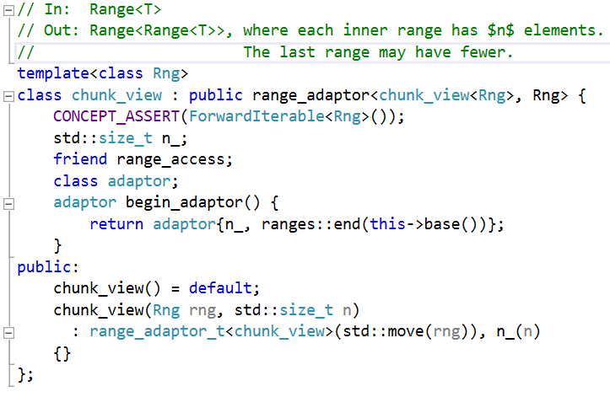
Chunking: Custom Range Adaptor

Slide 40

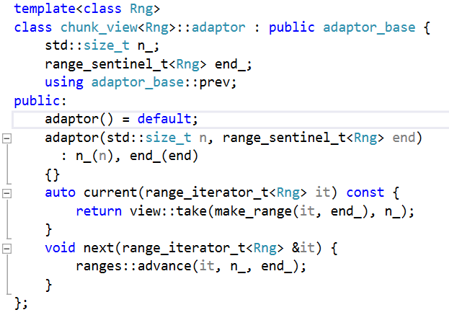
Chunking: Custom Range Adaptor

Slide 41
Chunking: Custom Range Adaptor

Slide 42
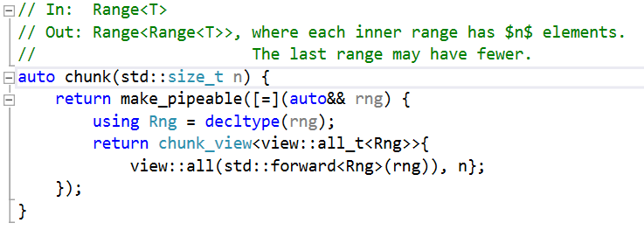

Chunking: Custom Range Adaptor

Slide 43
make_pipeable
“chunk” takes two arguments:
The range to chunk
The size of the chunks
“rng | chunk(n)”
Must return an object that has overloaded operator|

Slide 44
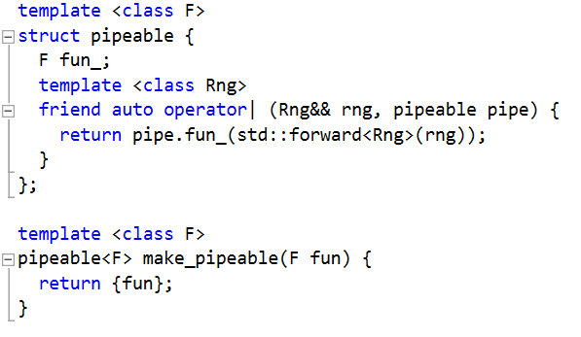
make_pipeable
Forwards the arg to the function
A function of 1 argument

Slide 45
Chunking: Custom Range Adaptor

Slide 46
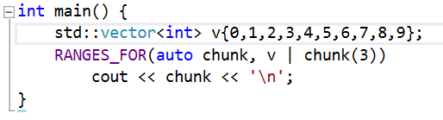
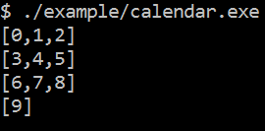
Chunking: Custom Range Adaptor

Slide 47

Transpose Range of Ranges

Slide 48
Transpose Range of Ranges
January | Jan Wk 1 | Jan Wk 2 | Jan Wk 3 | Jan Wk 4 | Jan Wk 5 | Jan Wk 6
February | Feb Wk 1 | Feb Wk 2 | Feb Wk 3 | Feb Wk 4 | Feb Wk 5 | Feb Wk 6
March | Mar Wk 1 | Mar Wk 2 | Mar Wk 3 | Mar Wk 4 | Mar Wk 5 | Mar Wk 6
1. Interleave
January
February
March
Jan Wk 1
Feb Wk 1
Mar Wk 1
Jan Wk 2
…
January | February | March
Jan Wk 1 | Feb Wk 1 | Mar Wk 1
Jan Wk 2 | Feb Wk 2 | Mar Wk 2
Jan Wk 3 | Feb Wk 3 | Mar Wk 3
Jan Wk 4 | Feb Wk 4 | Mar Wk 4
Jan Wk 5 | Feb Wk 5 | Mar Wk 5
Jan Wk 6 | Feb Wk 6 | Mar Wk 6
2. Chunk

Slide 49
Facade Pattern
“A facade is an object that provides a simplified interface to a larger body of code […]”
-- Wikipedia
https://en.wikipedia.org/wiki/Facade_pattern

Slide 50
Range Facade
Facade Range
Iterator
op*
cursor_
op==
Cursor
current
begin
op!=
next
op++
done
end
op--
equal
...
prev
distance_to
advance
Interleave Facade
current
return the (I,J)^{th} element
next
Bump J. If J==max, bump I and set J to 0

Slide 51
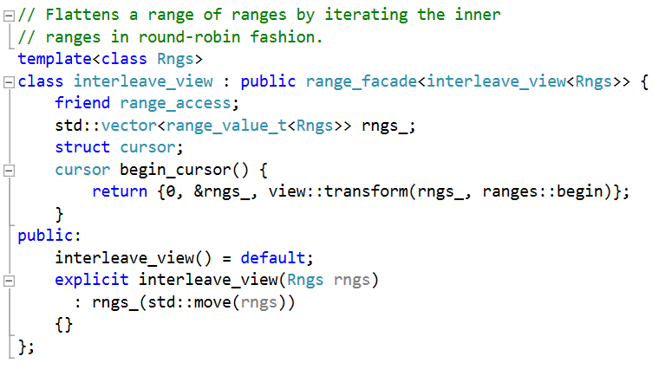
Interleave: Custom Range Facade

Slide 52
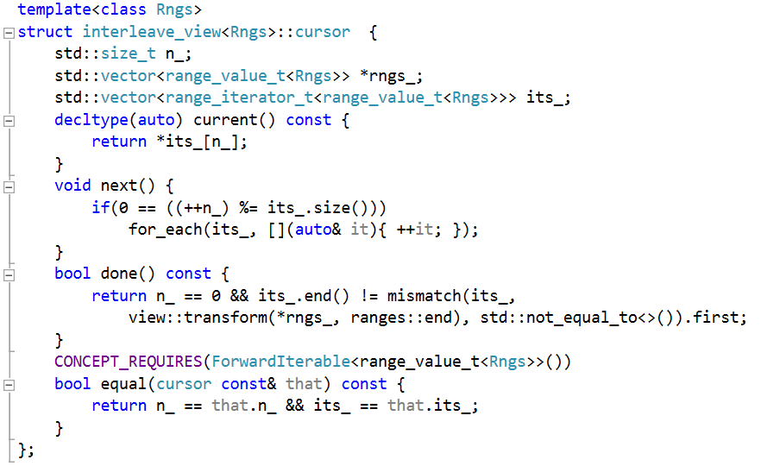
Interleave: Custom Range Facade

Slide 53
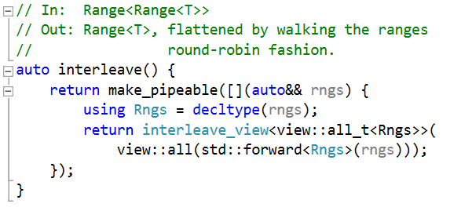
Interleave: Custom Range Facade

Slide 54
Interleave: Custom Range Facade

Slide 55
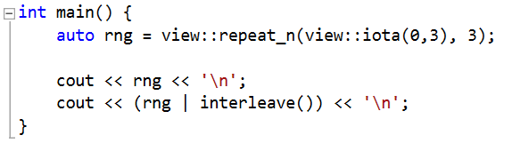

Interleave: Custom Range Facade

Slide 56
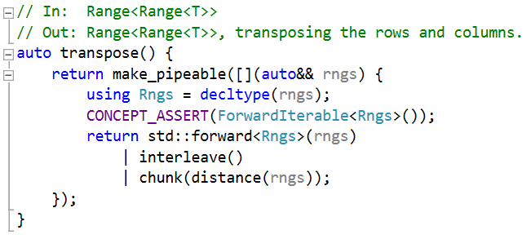
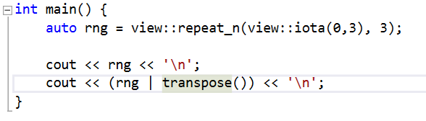

Transpose Range of Ranges

Slide 57
Side-by-Side Month Layout
Chunk months into groups of 3’s.
For each group of 3 months, transpose the “rows” and “columns”.
Join the chunks created in step 1
Join the strings of the inner ranges.
Print!
Take the rest of the day off.

Slide 58
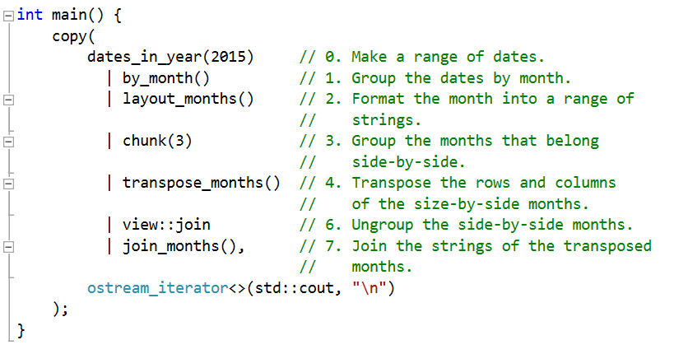
Solution

Slide 59
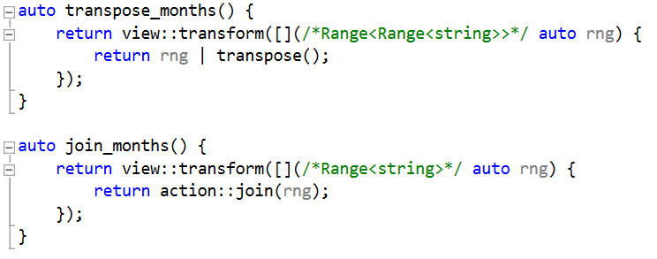
Solution

Slide 60
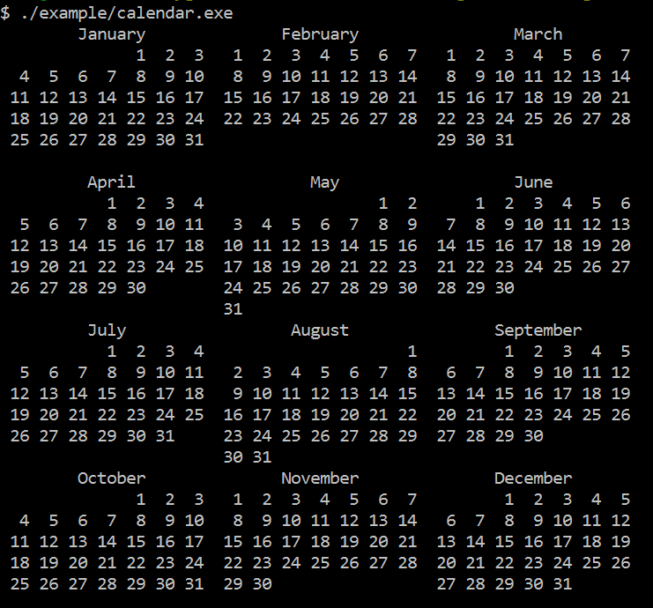
Ta-da!

Slide 61
Calendar Solution
Composable
Reusable
Works with infinite ranges
Can show N months side-by-side
No loops!!!
Correct by construction.
Notes:
Declarative, mostly functional.
One if statement, no loops, little state.

Slide 62
#include <cstddef>
#include <string>
#include <vector>
#include <utility>
#include <iostream>
#include <stdexcept>
#include <functional>
#include <boost/format.hpp>
#include <boost/lexical_cast.hpp>
#include <boost/date_time/gregorian/gregorian.hpp>
#include <range/v3/all.hpp>
namespace greg = boost::gregorian;
using date = greg::date;
using day = greg::date_duration;
using namespace ranges;
using std::cout;
namespace boost { namespace gregorian {
date &operator++(date &d) { return d = d + day(1); }
date operator++(date &d, int) { return ++d - day(1); }
}}
namespace ranges {
template<> struct difference_type<date> {
using type = date::duration_type::duration_rep::int_type;
};
}
CONCEPT_ASSERT(Incrementable<date>());
auto dates_in_year(int year) {
return view::iota(date{year,greg::Jan,1},
date{year+1,greg::Jan,1});
}
auto by_month() {
return view::group_by([](date a, date b) {
return a.month() == b.month();
});
}
auto by_week() {
return view::group_by([](date a, date b) {
// ++a because week_numer is Mon-Sun and we want Sun-Sat
return (++a).week_number() == (++b).week_number();
});
}
std::string format_day(date d) {
return boost::str(boost::format("%|3|") % d.day());
}
// In: Range<Range<date>>: month grouped by weeks.
// Out: Range<std::string>: month with formatted weeks.
auto format_weeks() {
return view::transform([](/*Range<date>*/ auto week) {
return boost::str(boost::format("%1%%2%%|22t|")
% std::string((int)front(week).day_of_week() * 3, ' ')
% (week | view::transform(format_day) | action::join));
});
}
// Return a formatted string with the title of the month
// corresponding to a date.
std::string month_title(date d) {
return boost::str(boost::format("%|=22|")
% d.month().as_long_string());
}
// In: Range<Range<date>>: year of months of days
// Out: Range<Range<std::string>>: year of months of formatted wks
auto layout_months() {
return view::transform([](/*Range<date>*/ auto month) {
int week_count = distance(month | by_week());
return view::concat(
view::single(month_title(front(month))),
month | by_week() | format_weeks(),
view::repeat_n(std::string(22,' '),6-week_count));
});
}
// In: Range<T>
// Out: Range<Range<T>>, where each inner range has $n$ elements.
// The last range may have fewer.
template<class Rng>
class chunk_view : public range_adaptor<chunk_view<Rng>, Rng> {
CONCEPT_ASSERT(ForwardIterable<Rng>());
std::size_t n_;
friend range_access;
class adaptor;
adaptor begin_adaptor() {
return adaptor{n_, ranges::end(this->base())};
}
public:
chunk_view() = default;
chunk_view(Rng rng, std::size_t n)
: range_adaptor_t<chunk_view>(std::move(rng)), n_(n)
{}
};
template<class Rng>
class chunk_view<Rng>::adaptor : public adaptor_base {
std::size_t n_;
range_sentinel_t<Rng> end_;
using adaptor_base::prev;
public:
adaptor() = default;
adaptor(std::size_t n, range_sentinel_t<Rng> end)
: n_(n), end_(end)
{}
auto current(range_iterator_t<Rng> it) const {
return view::take(make_range(std::move(it), end_), n_);
}
void next(range_iterator_t<Rng> &it) {
ranges::advance(it, n_, end_);
}
};
// In: Range<T>
// Out: Range<Range<T>>, where each inner range has $n$ elements.
// The last range may have fewer.
auto chunk(std::size_t n) {
return make_pipeable([=](auto&& rng) {
using Rng = decltype(rng);
return chunk_view<view::all_t<Rng>>{
view::all(std::forward<Rng>(rng)), n};
});
}
// Flattens a range of ranges by iterating the inner
// ranges in round-robin fashion.
template<class Rngs>
class interleave_view : public range_facade<interleave_view<Rngs>> {
friend range_access;
std::vector<range_value_t<Rngs>> rngs_;
struct cursor;
cursor begin_cursor() {
return {0, &rngs_, view::transform(rngs_, ranges::begin)};
}
public:
interleave_view() = default;
explicit interleave_view(Rngs rngs)
: rngs_(std::move(rngs))
{}
};
template<class Rngs>
struct interleave_view<Rngs>::cursor {
std::size_t n_;
std::vector<range_value_t<Rngs>> *rngs_;
std::vector<range_iterator_t<range_value_t<Rngs>>> its_;
decltype(auto) current() const {
return *its_[n_];
}
void next() {
if(0 == ((++n_) %= its_.size()))
for_each(its_, [](auto& it){ ++it; });
}
bool done() const {
return n_ == 0 && its_.end() != mismatch(its_,
view::transform(*rngs_, ranges::end), std::not_equal_to<>()).first;
}
CONCEPT_REQUIRES(ForwardIterable<range_value_t<Rngs>>())
bool equal(cursor const& that) const {
return n_ == that.n_ && its_ == that.its_;
}
};
// In: Range<Range<T>>
// Out: Range<T>, flattened by walking the ranges
// round-robin fashion.
auto interleave() {
return make_pipeable([](auto&& rngs) {
using Rngs = decltype(rngs);
return interleave_view<view::all_t<Rngs>>(
view::all(std::forward<Rngs>(rngs)));
});
}
// In: Range<Range<T>>
// Out: Range<Range<T>>, transposing the rows and columns.
auto transpose() {
return make_pipeable([](auto&& rngs) {
using Rngs = decltype(rngs);
CONCEPT_ASSERT(ForwardIterable<Rngs>());
return std::forward<Rngs>(rngs)
| interleave()
| chunk(distance(rngs));
});
}
// In: Range<Range<Range<string>>>
// Out: Range<Range<Range<string>>>, transposing months.
auto transpose_months() {
return view::transform([](/*Range<Range<string>>*/ auto rng) {
return rng | transpose();
});
}
// In: Range<Range<string>>
// Out: Range<string>, joining the strings of the inner ranges
auto join_months() {
return view::transform([](/*Range<string>*/ auto rng) {
return action::join(rng);
});
}
int main(int argc, char *argv[]) try {
if(argc < 2) {
std::cerr << "Please enter the year to format.\n";
std::cerr << boost::format(" Usage: %1% <year>\n") % argv[0];
return 1;
}
int year = boost::lexical_cast<int>(argv[1]);
int months_per_line = 3;
auto calendar =
// Make a range of all the dates in a year:
dates_in_year(year)
// Group the dates by month:
| by_month()
// Format the month into a range of strings:
| layout_months()
// Group the months that belong side-by-side:
| chunk(months_per_line)
// Transpose the rows and columns of the size-by-side months:
| transpose_months()
// Ungroup the side-by-side months:
| view::join
// Join the strings of the transposed months:
| join_months();
// Write the result to stdout:
copy(calendar, ostream_iterator<>(std::cout, "\n"));
}
catch(std::exception &e) {
std::cerr << "ERROR: Unhandled exception\n";
std::cerr << " what(): " << e.what();
return 1;
}

Slide 63


Ranges and Standardization
Feature | Already Proposed? | Will be Proposed?
Range concepts
Range algorithms
View adaptors
Range actions
Façade/Adaptor helpers

Slide 64
Standardization Timeline
2014 Oct
Initial proposal of the design.
2015 May
Cursory review of concepts and algorithms.
Present
Detailed wording review of concepts and algorithms.
Draft other range-related proposals[¹].
2015 Oct (??)
Vote initial wording into a draft TS.
Review wording of other proposals.
Next year(s)
Even more range-related proposals[²].
[¹] proxy iterators
???
TS is approved.
[²] Infinite ranges, range views and actions, façade, adaptor.
???
TS is merged into C++XY as STL2.

Slide 65
Find Out More
N4128
High-level design, rationale, comparative analysis
http://www.open-std.org/jtc1/sc22/wg21/docs/papers/2014/n4128.html
N4382
Standard wording for concepts, iterators, algorithms
http://www.open-std.org/JTC1/SC22/WG21/docs/papers/2015/n4382.pdf
Range v3 library
C++11 implementation
http://www.github.com/ericniebler/range-v3

Slide 66
Questions?

